Slide 1
Data-Driven Control for DC motor
Oraz Ospanov
Asset Malik
Andrey Yershov

Slide 2
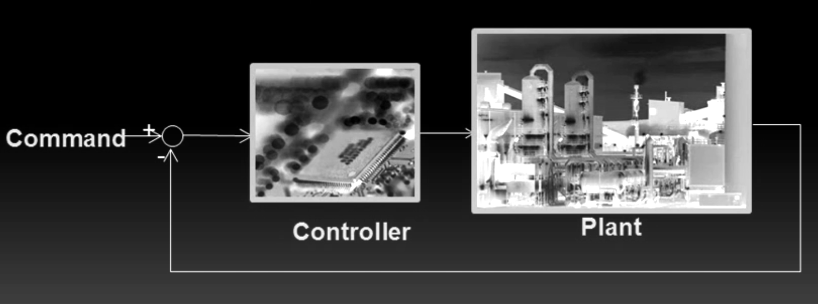
What is control theory?
Data-driven control. (n.d.). Retrieved February 18, 2021, from https://www.mathworks.com/matlabcentral/fileexchange/42758-data-driven-control

Slide 3
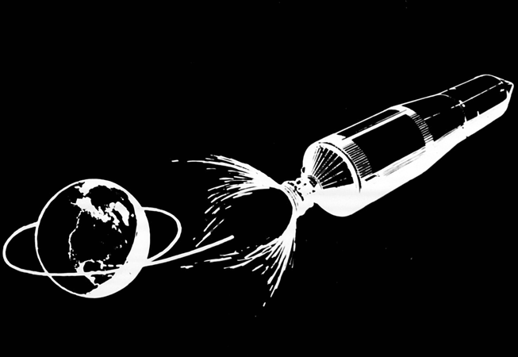
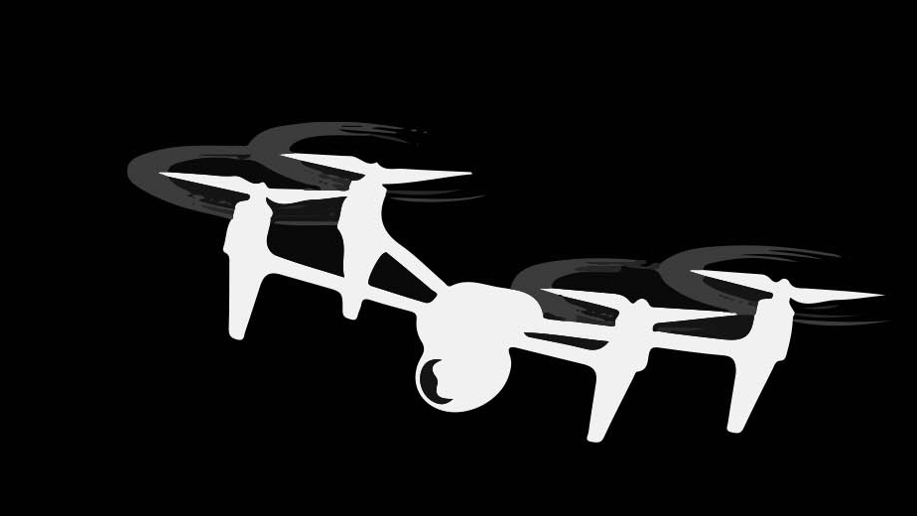
Motivation for Data-Driven approach
≠

Slide 4
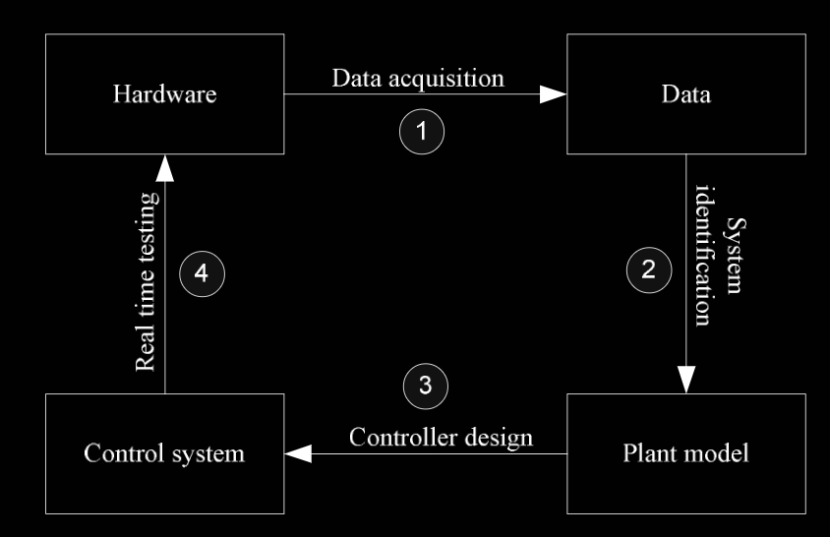
Data-Driven approach
Y. Naung, A. Schagin, H. Oo, K. Ye, and Z. Khaing, “Implementation of data driven control system of dc motor by using system identification process,” in 2018 IEEE Conference of Russian Young Researchers in Electrical and Electronic Engineering

Slide 5
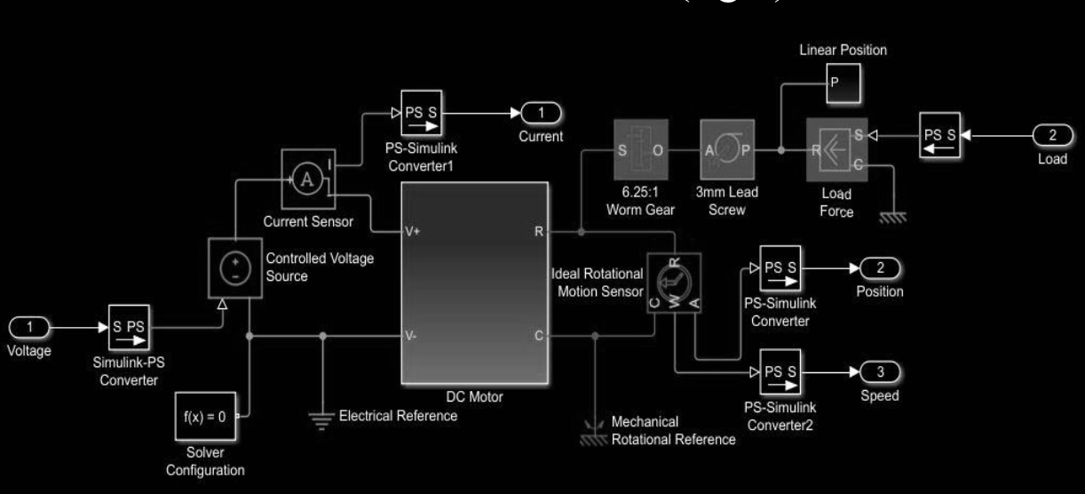
Related work
DDC for Simulated DC motors
Y. Naung, A. Schagin, H. Oo, K. Ye, and Z. Khaing, “Implementation of data driven control system of dc motor by using system identification process,” in 2018 IEEE Conference of Russian Young Researchers in Electrical and Electronic Engineering

Slide 6
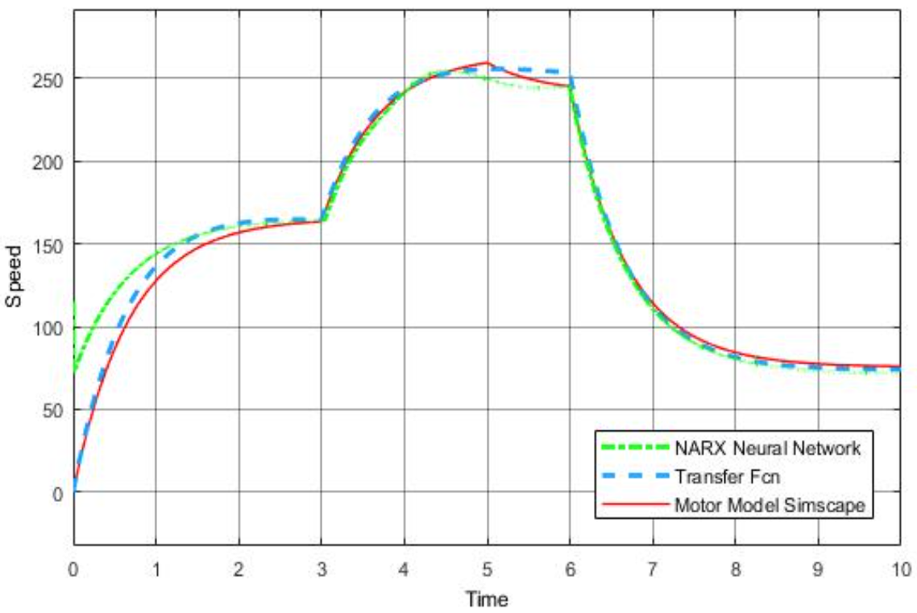
DeePC algorithm for real-time DDC
P. G. Carlet, A. Favato, S. Bolognani, and F. D ̈orfler, “Data-driven predictive currentcontrol for synchronous motor drives,” in 2020 IEEE Energy Conversion Congress andExposition (ECCE), pp. 5148–5154, IEEE, 2020.

Slide 7
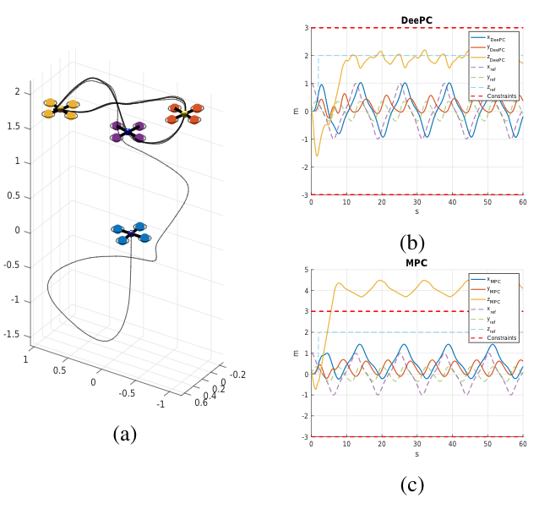
Real-Time Data Driven Predictive Control
J. Coulson, J. Lygeros, and F. D ̈orfler, “Data-enabled predictive control: In the shallows of the deepc,” in 2019 18th European Control Conference (ECC) pp. 307–312, IEEE, 2019.

Slide 8
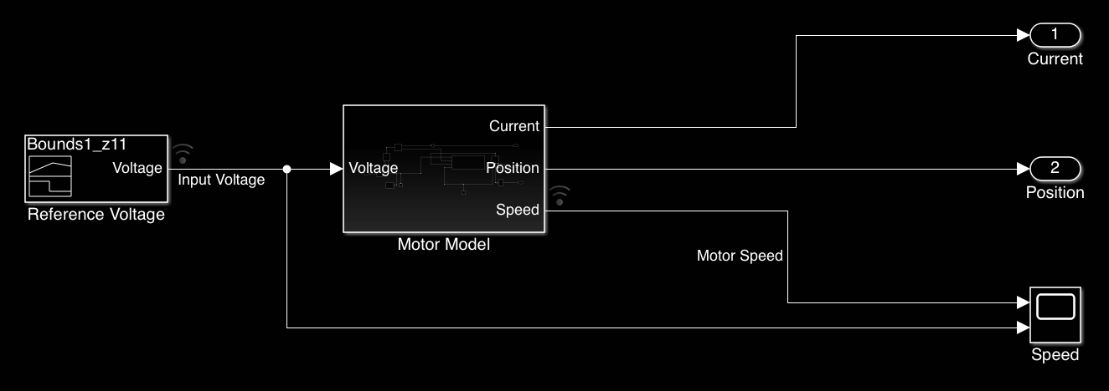
#1: Model for Data acquisition with MATLAB simulation
Data-driven control. Retrieved February 18, 2021, from https://www.mathworks.com/matlabcentral/fileexchange/42758-data-driven-control

Slide 9
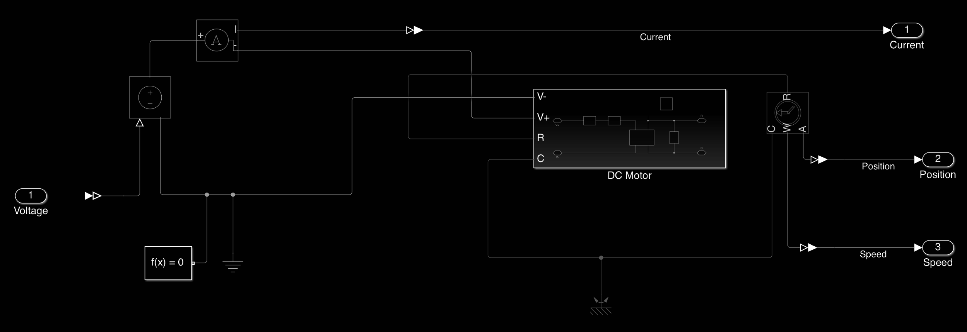
DC motor model in MATLAB simulation
Data-driven control. Retrieved February 18, 2021, from https://www.mathworks.com/matlabcentral/fileexchange/42758-data-driven-control

Slide 10
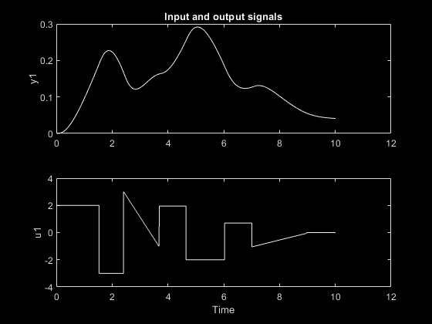
Sample of data acquisition experiment

Slide 11
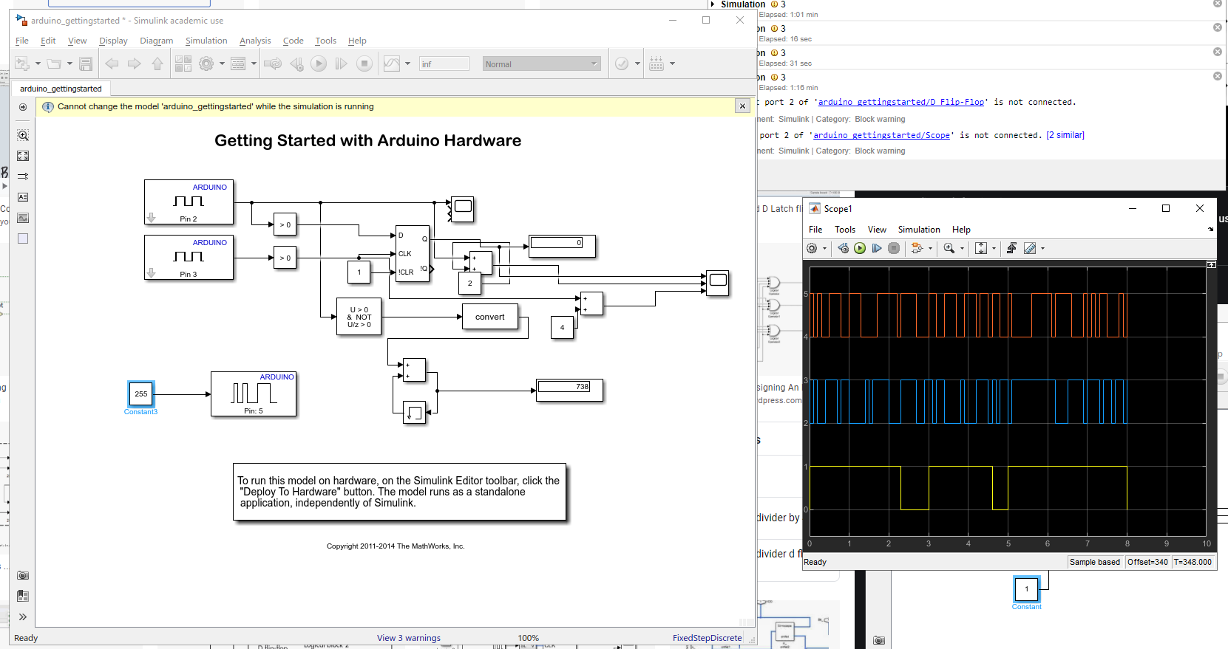
#2: Arduino Hardware

Slide 12
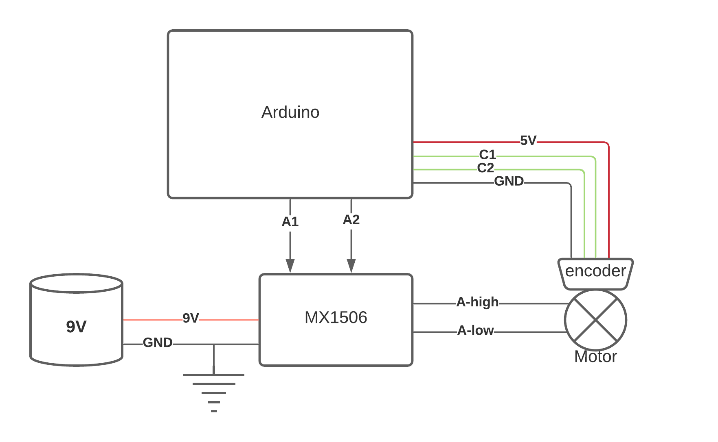
Arduino Hardware Setup #1

Slide 13
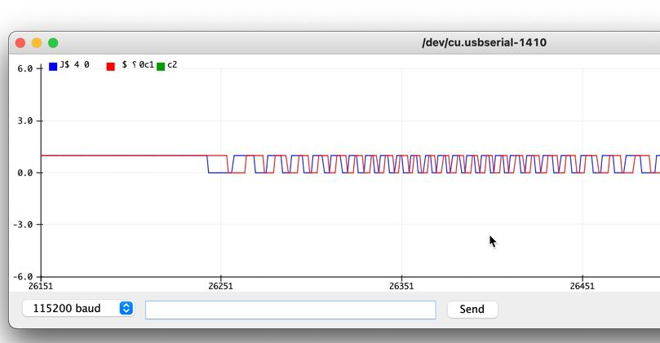
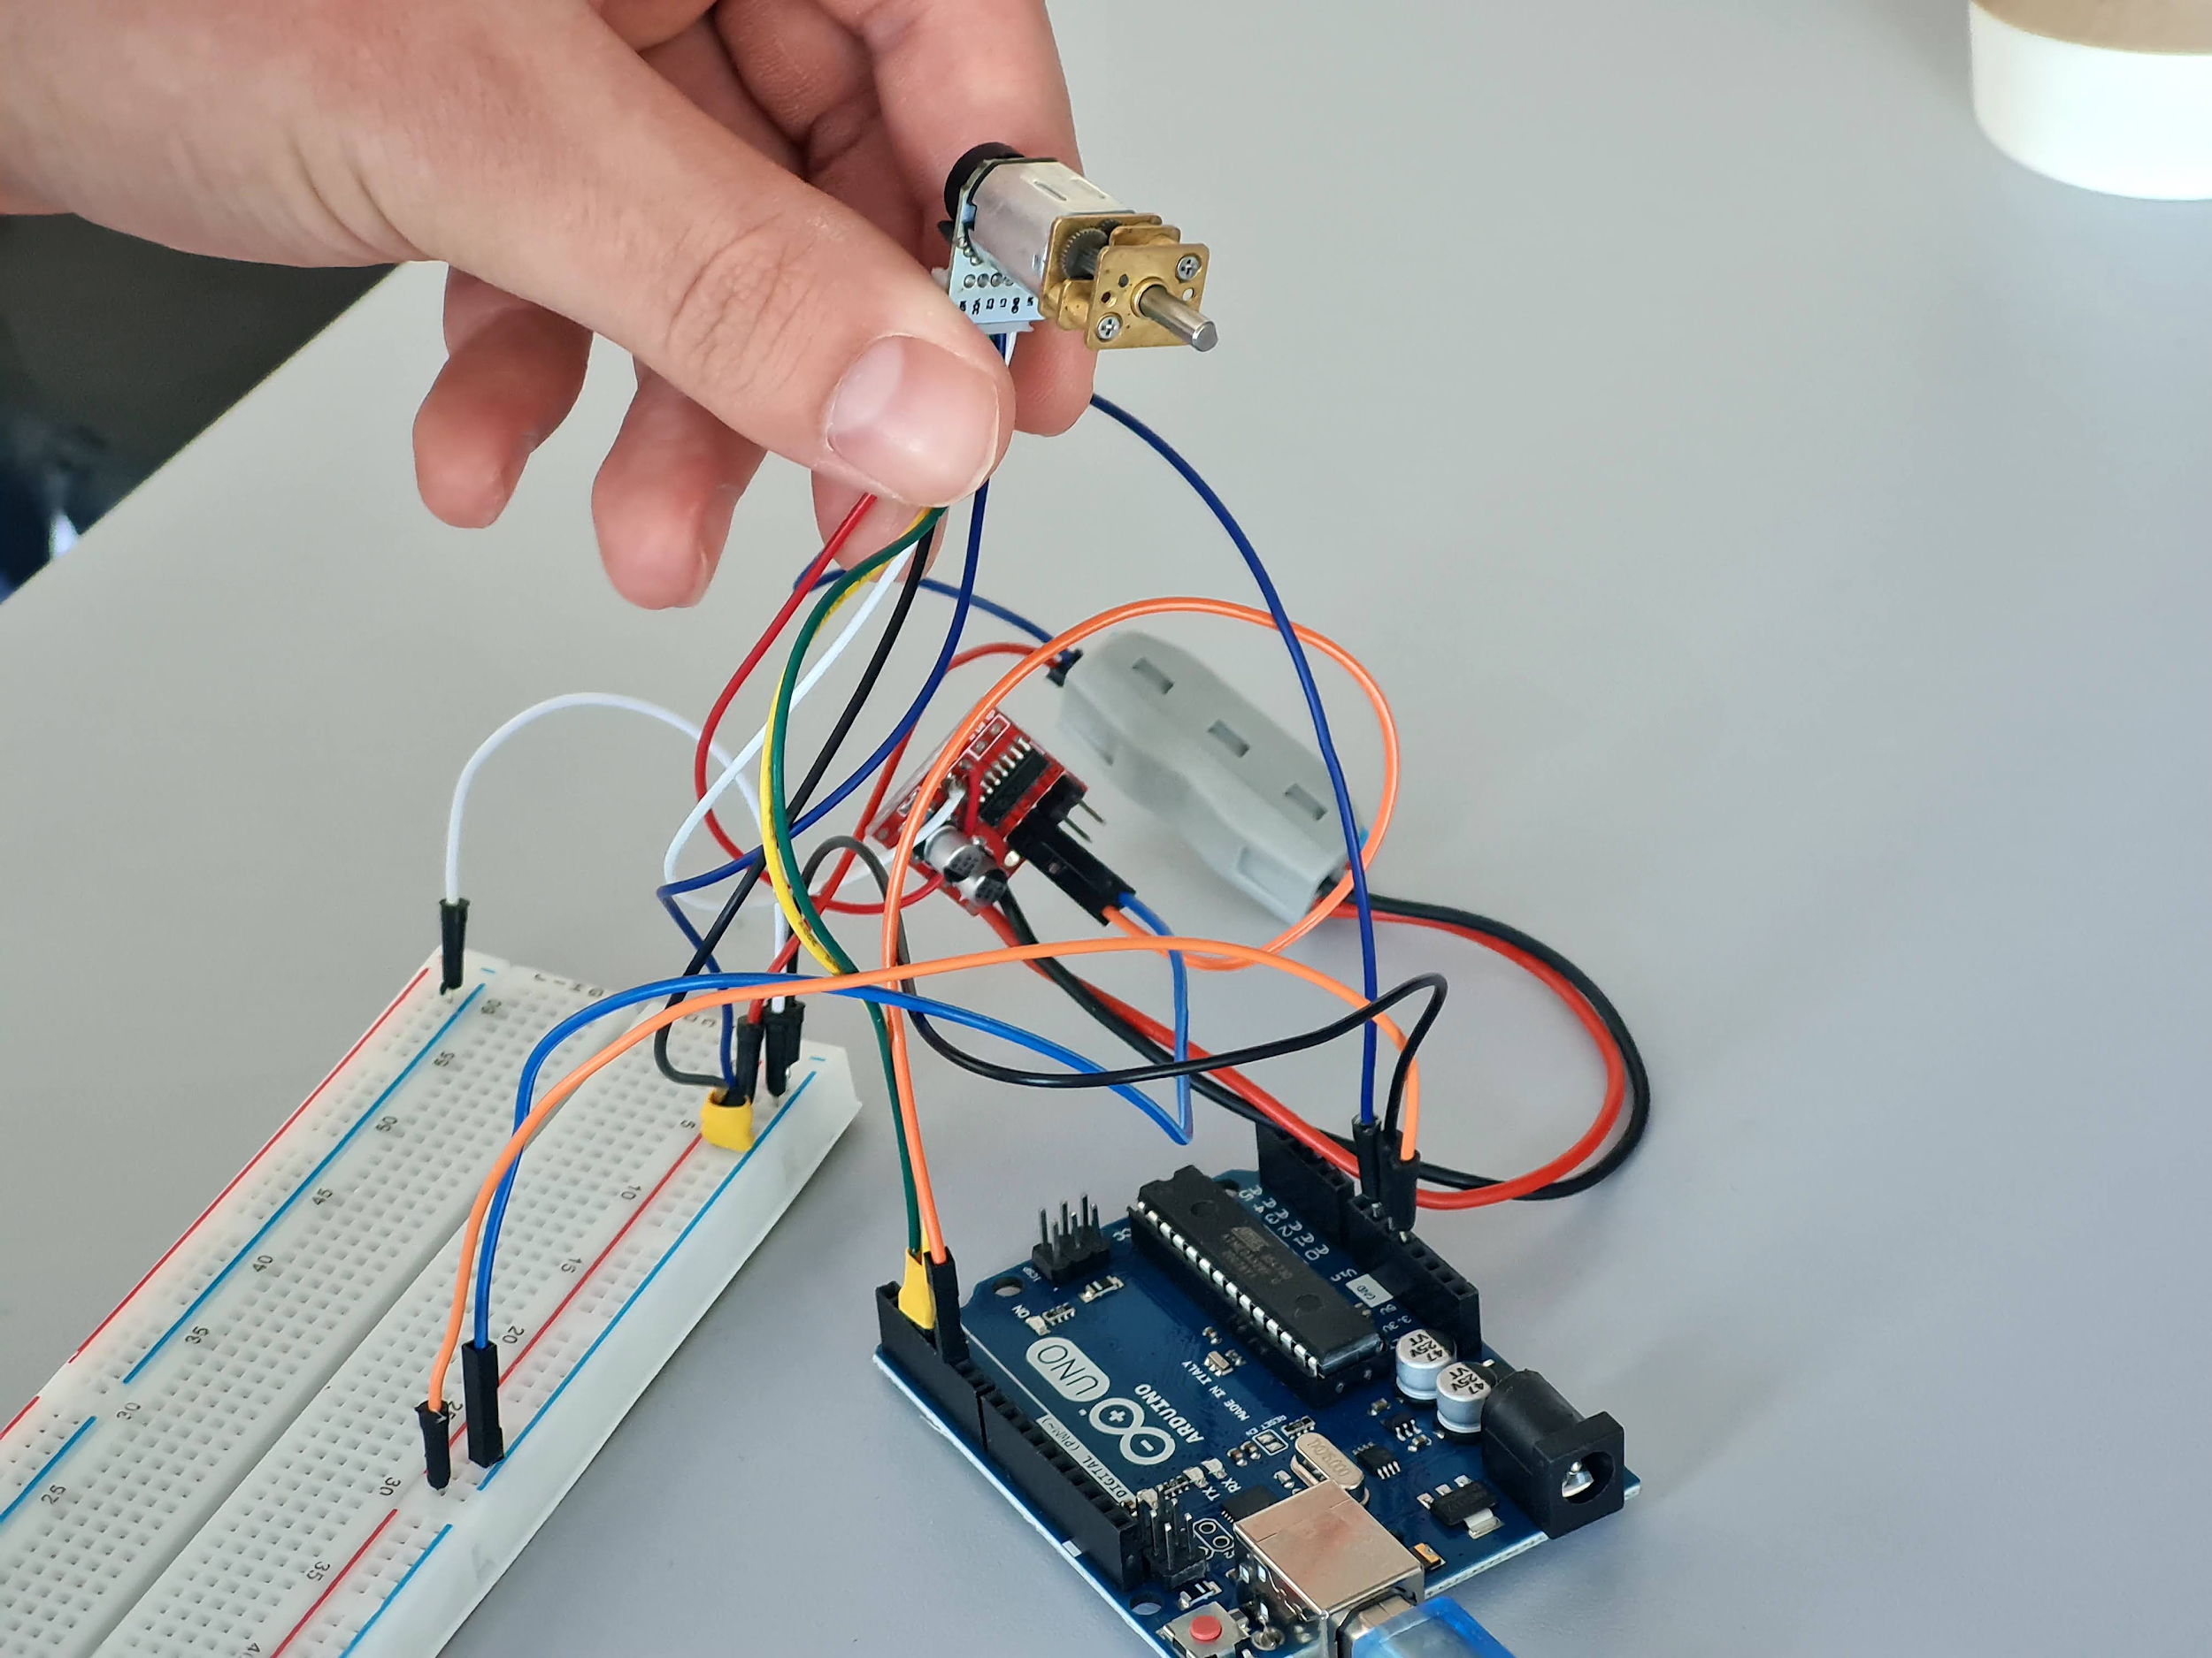
Arduino Hardware Setup #2

Slide 14
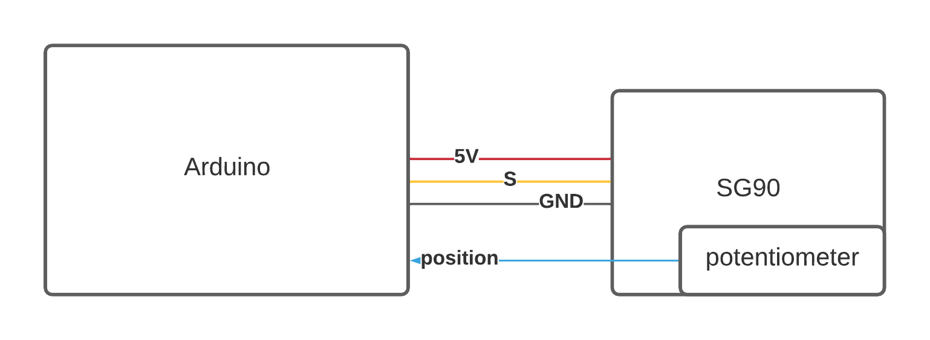
Arduino Hardware Setup #2

Slide 15
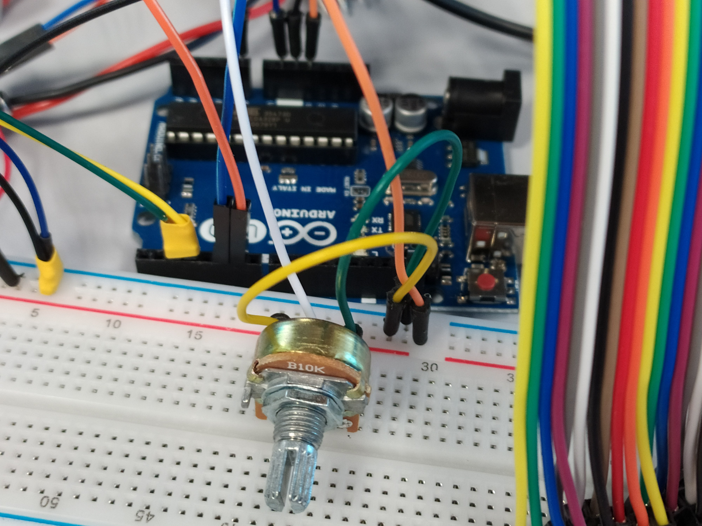

Slide 16
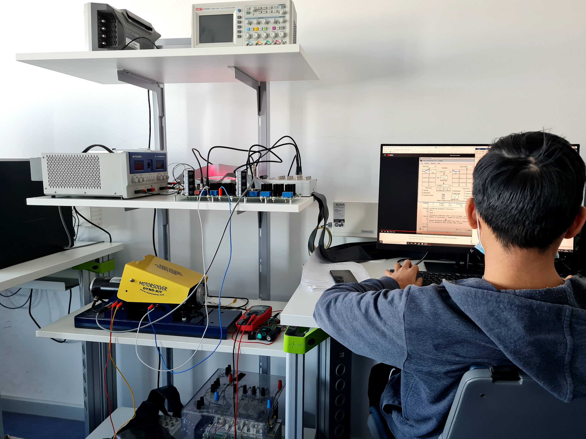
#3 dSpace Hardware setup

Slide 17
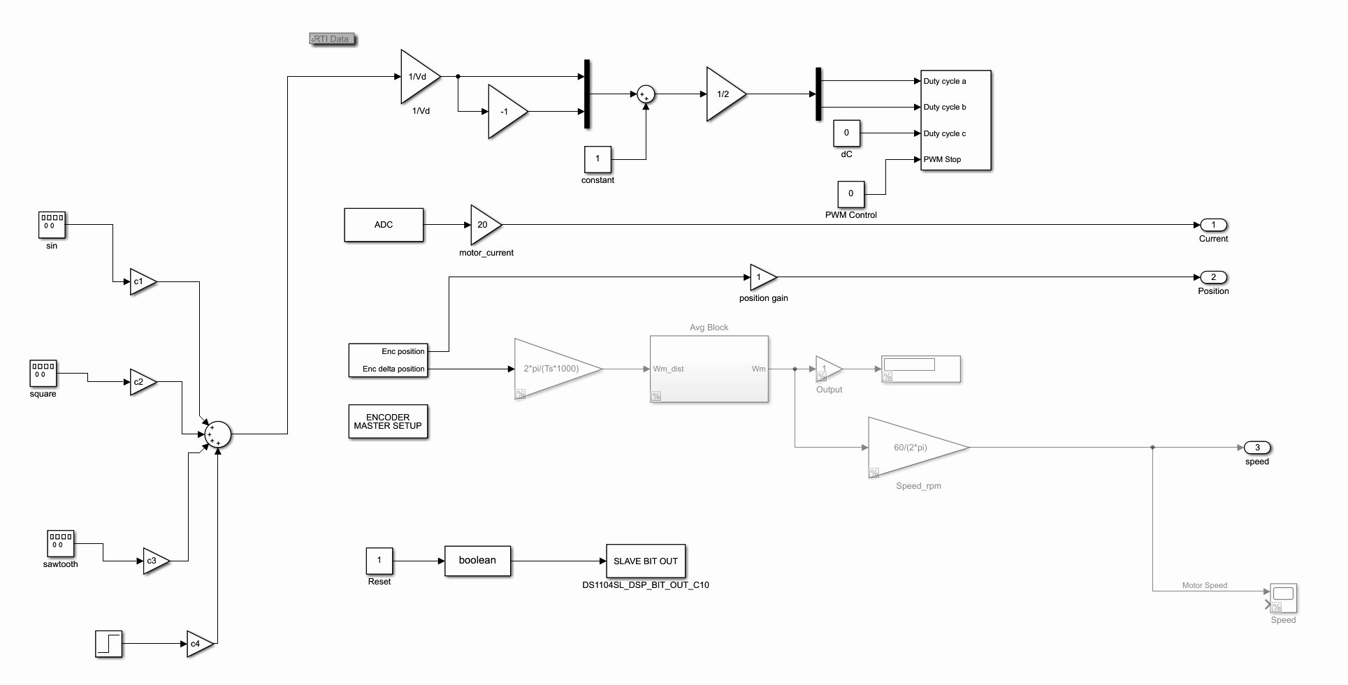
dSpace control model

Slide 18
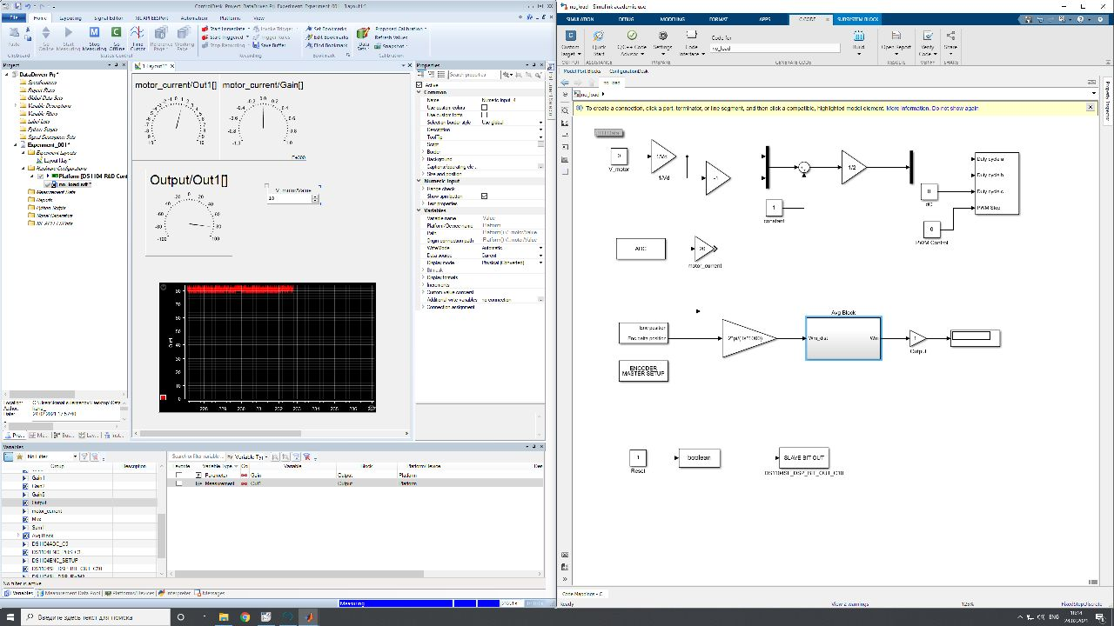
dSpace Model for data acquisition

Slide 19
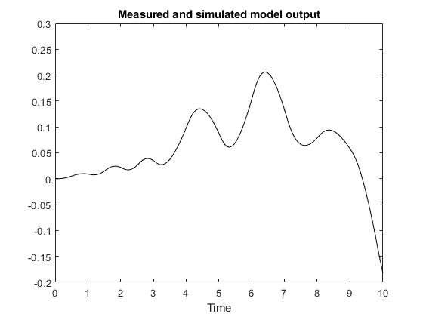
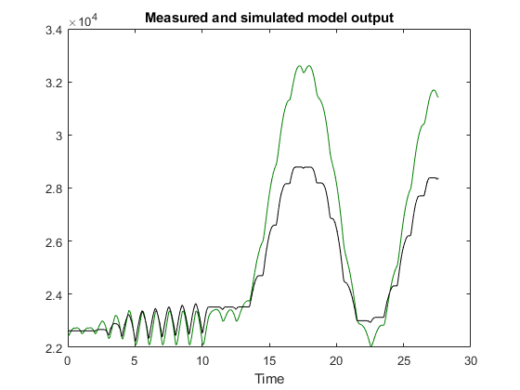
Synthesized plant model Results
MATLAB simulation - 97% accuracy, linear approximation
Arduino setup - aliasing issue, further work needed
dSpace setup - 73% accuracy, linear approximation
Simulated DC motor
dSpace DC motor

Slide 20
Conclusion and Future Work
4 different setups were built for DDC
The acquired data was analyzed in MATLAB, controllers were synthesized
Next up: fine tune the controller on dSpace
Try another microcontroller setup
In case of success, implement reinforcement learning based on microcontroller.

